Slide 1
Scientific Investigations
Lesson 1.2

Slide 2
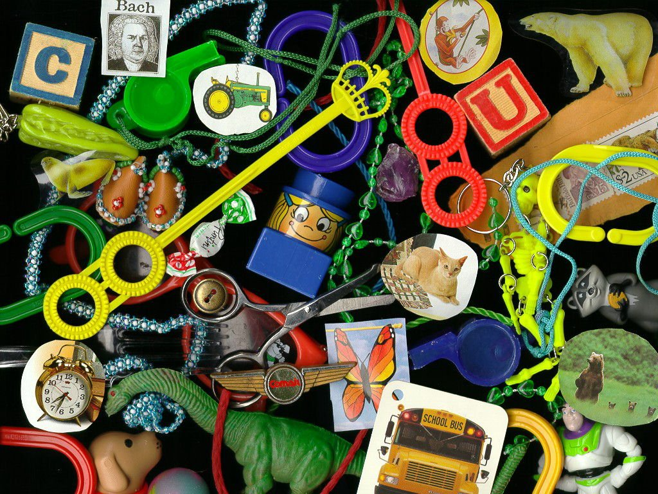

Slide 3
What are the three ways we can investigate scientific questions?

Slide 4
How do we investigate science?
An experiment is an organized procedure to study something under controlled conditions. They may be done in the field or the lab.
Observation is the process of obtaining information by using the senses.
Models are useful for studying things that are very small, large, or complex.

Slide 5
Types of Investigations
Investigation Type | Benefits | Limitations
Experiments | Organized procedure Control of an environment Can be repeated | May take long periods of time to repeat experiments Expensive equipment
Observations | Low cost, minimal equipment Uses senses | People sense things differently (sound, taste, touch, sight)
Models | Help understand ideas that are too small, big, or dangerous | Cannot control all factors in a model Not an exact replica

Slide 6
Parts of a Scientific Investigation
Scientific investigations share certain basic elements.
A hypothesis is a testable explanation that leads to a scientific investigation.
To be useful, a hypothesis has to be testable in a practical and meaningful way.

Slide 7
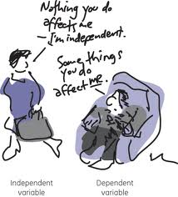
Parts of a Scientific Investigation
An independent variable is the factor that is deliberately changed in the experiment. Usually on x-axis
A dependent variable is changes as a result of how the independent variable is changed. Usually on y-axis.

Slide 8
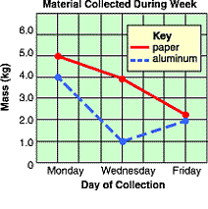
Variables

Slide 9
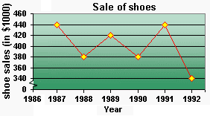

Slide 10
Nick wanted to see how high an ice cube would float in different temperatures of water. Identify the independent variable.
Height of ice cube
Temperature of ice cube
Size of ice cube
Amount of water
Temperature of water

Slide 11
Mario studied how far room temperature water would spurt out of a plastic milk carton when 3mm holes were punched at different heights from the bottom of the container. Identify the independent variable.
Distance water traveld out of the carton
Different heights of the holes in container
Ice water from Iceland

Slide 12
Tiffany was investingating how fast it took Hayden to react to different sounds. Identify the independent variable
How fast Hayden reacted
How much time it took Hayden to react
Different sounds
Hayden

Slide 13
Mrs. Crain wanted to see how different types of music affected students' pulse rates. She played different types of music: heavy metal, rap, R&B, alternative, pop, country, and classical music. Identify the independent variable.
Types of music
Pulse rate
Mrs. Crain
Classical music resulted in the highest pulse rate.

Slide 14
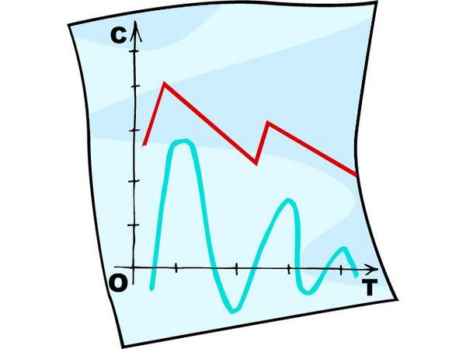
Parts of a Scientific Investigation
Data are information gathered by observation or experimentation that can be used in calculating or reasoning.
Scientists analyze data to understand the relationship between the independent variable and the dependent variable.
Based on their analysis of the data, scientists draw conclusions about the hypothesis.

Slide 15
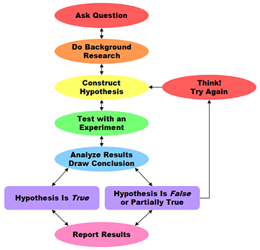
Scientific Method
Scientific investigations do not always follow exactly the same steps in the same order.
Some of the steps can be repeated.

Slide 16
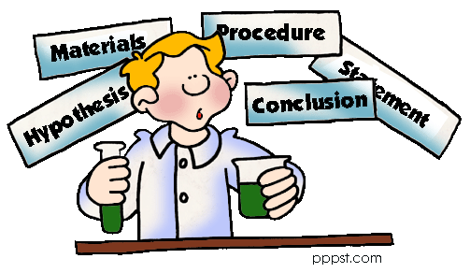
After the experiment…
Experiments must be verified by repetition and replication.
Results must be reviewed by other scientists not involved in the investigation.

Slide 17
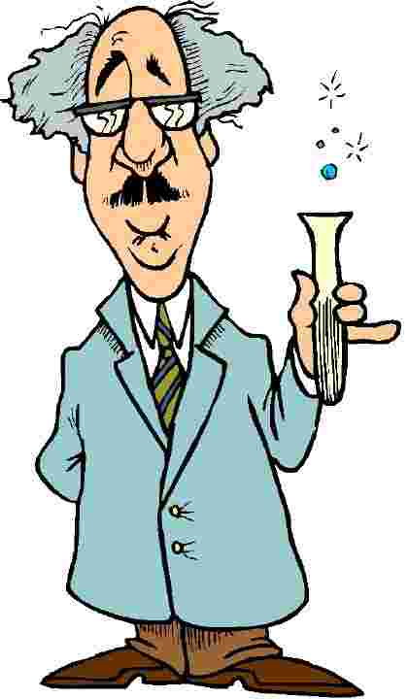
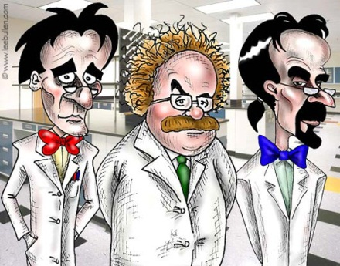
Replication versus Repetition?
REPETITION
REPLICATION
Repetition is done when the same scientist repeats the study in the same location.
Replication is done when other scientists reproduce the study in different locations.

Slide 18
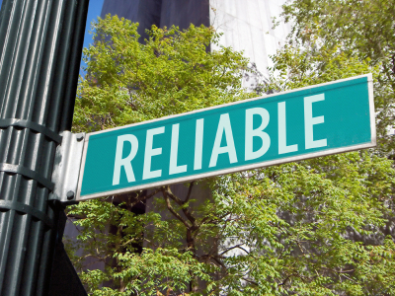
How do we know the results are reliable and trustworthy?
Peer-reviewed scientific journals are the most reliable.
Books written by scientists about their field of study are trustworthy.
Government or academic web pages are the most reliable Internet sources.
Commercial web pages are often unreliable.

